Slide 1
self-supervised techniqu

Slide 2


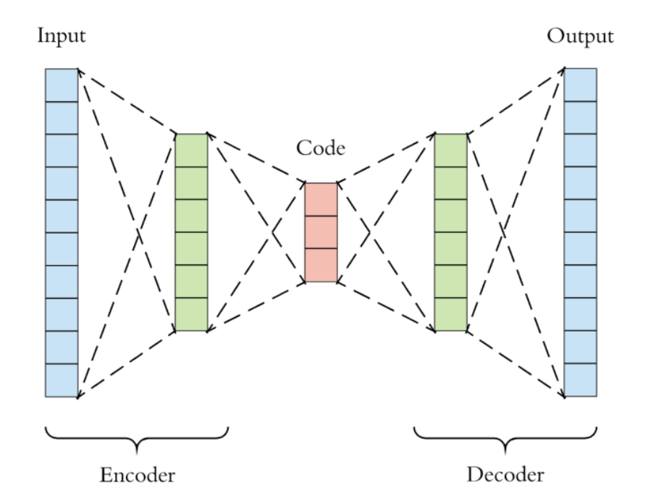
Train Test
?

Slide 3
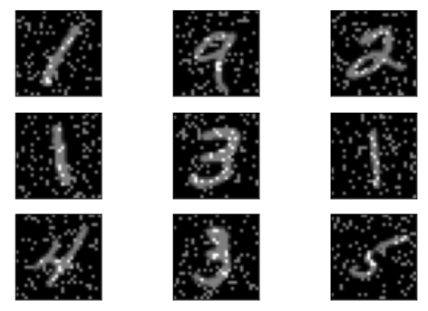
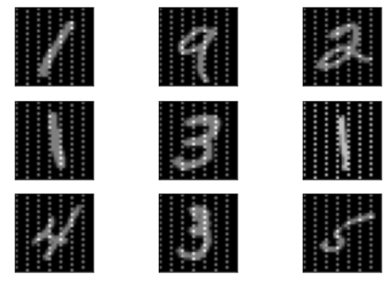
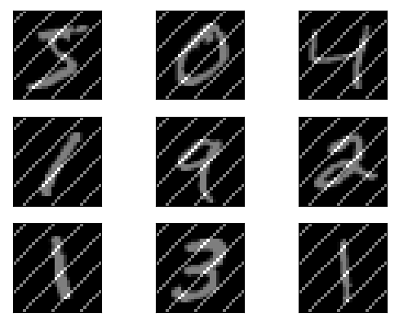

Slide 4
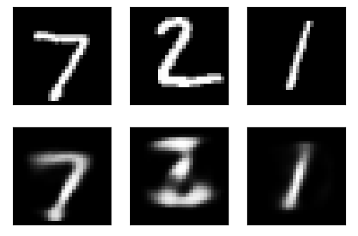


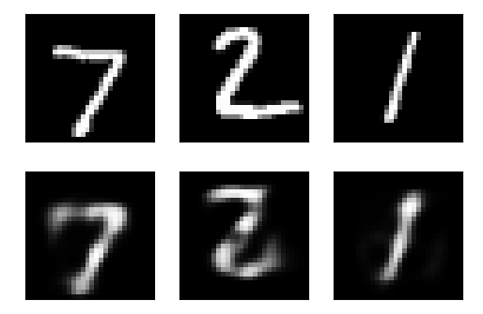
Train and test on regular (loss 0.1463)
Train on regular, test on random
Train and test on random (loss 0.1457)
Train on random, test on regular

